Slide 1
Superscalar Architecture (SSA)
Matthew McMillian
mgm160130

Slide 2
Presentation Aims
Introduction – What and Why?
Key Features
Limitations
Overview of Process
Conclusions

Slide 3
What is Superscalar Architecture?
Superscalar Architecture is a type of architecture that is designed to improve the performance and execution of scalar instructions. Scalar instructions include, but are not limited to:
Any variable that holds only one atomic value at a time (Integer)
Any process that processes one data item at a time
In a Superscalar System, several scalar instructions can be initialized simultaneously (in parallel) and executed independently through various methods such as pipelining, but you can also execute several instruction in the same pipelining phase, allowing for even faster execution times. This is called Instruction-Level Parallelism.

Slide 4
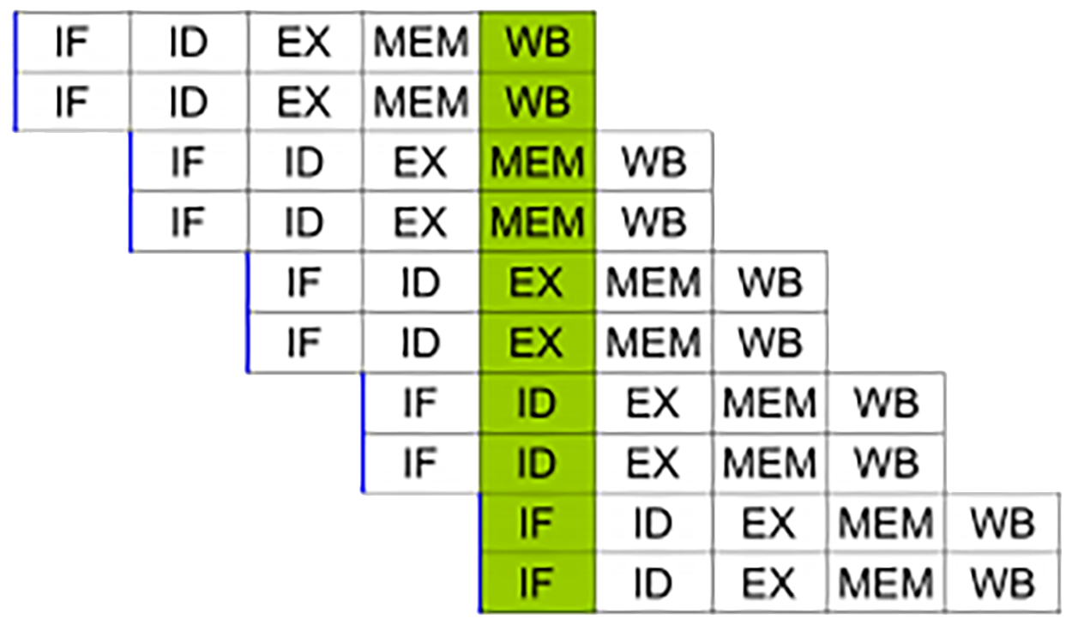
Why Should We Care?
Most operations are on scalar quantities (about 80%(1)). Increasing performance in this area will lead to a huge increase in the overall performance of the system.
Eliminates unnecessary dependencies by use of additional registers and renaming of register references.
Simple superscalar pipeline. By fetching and dispatching two instructions at a time, a maximum of two instructions per cycle can be completed.

Slide 5
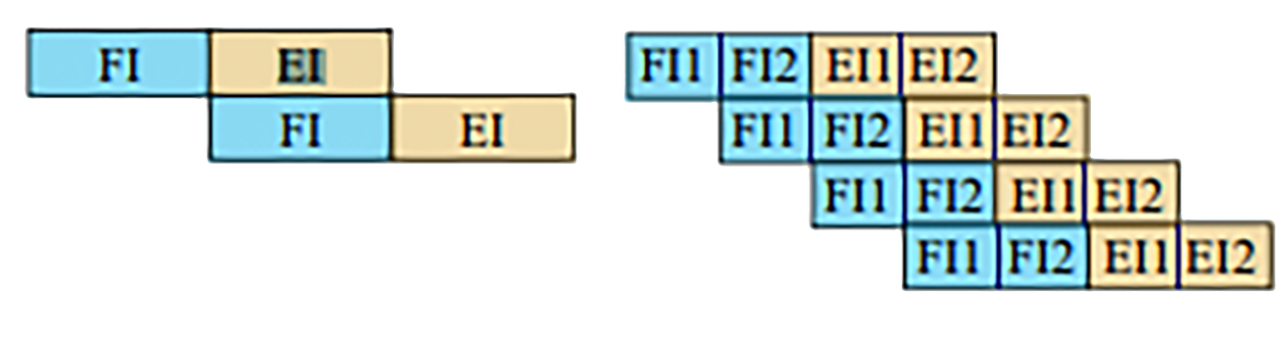
Key Feature of SSA: Superpipelining
Superpipelining divides the stages of a normal pipeline into several sub-stages, increasing the number of instructions that are handled at each stage. If you were to divide each stage into two sub-stages, the pipeline can perform at twice of the original speed. This amount increases by 2x each time you split the piping phase without extra hardware.
Benefits Include:
Several Instructions per Clock Cycle
Parallel Instruction Handling
2 Hardware Resources Needed 4 Hardware Resources Needed

Slide 6
Limitations of Parallel Execution
Dubbed ‘pipeline hazards’, there are some issues that prevent efficient execution in pipelined architecture.
Resource Hazards (When branches are too close to be handled correctly in the pipeline)
Control Dependency (when an instruction is dependent on the execution of a previous instruction)
Data Dependencies (when an instruction depends on the result of a previous instruction).
Hazards in SSA are particularly dangerous, as obstructions to the parallelisms could amount in a large performance loss.

Slide 7

Limitations: Resource Hazards
Resource Conflicts occur when several instructions compete for the same hardware resource at the same time. i.e., two instructions need the same unit for execution. Sometimes this is also known as structural hazards in pipelines.
Thankfully, resource hazards can be partially solved by introducing several hardware units for the same functions i.e., a processor may have two floating point units for floating point calculations
If there was only one cache, there would be a competition for resources among these two instructions

Slide 8
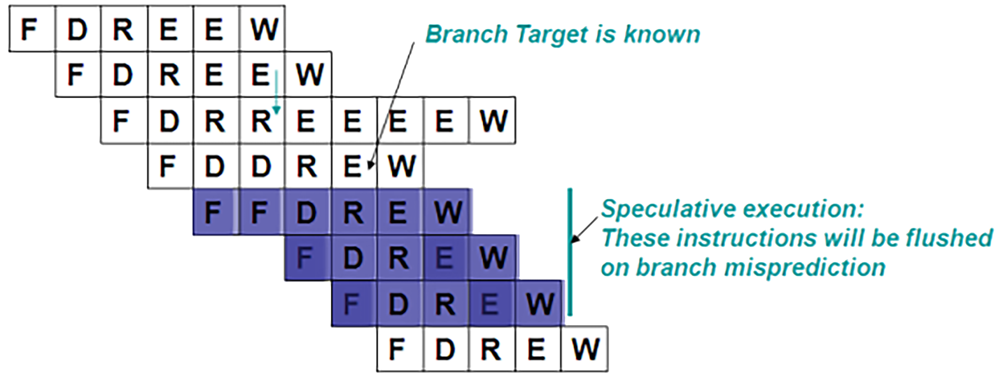
Limitations: Control Dependencies
Also known as procedural dependencies, these dependencies are typically caused by the presence of branches while trying to assure optimal parallelism. This is also similar to control hazards in pipelines.
If an instruction’s length isn’t CONSTANT, they cannot be fetched and used in parallel since an instruction has to be decoded. This means that Superpipelining is efficient for instructions with a fixed length and format.
Branch Mispredictions could lead to control dependencies

Slide 9

Limitations: Data Dependencies
Similar to data hazards in pipelines, a data dependency occurs when the pipeline changes the order of read/write access to operands so that the order differs from the order seen by sequentially instructions.
Because of the fragile nature of data dependencies, conflicts have to be handled much more carefully than other dependencies
Pipeline must wait for ‘D’ to finish before it can sub

Slide 10
How Does It Work?: Division and Decoupling
To increase instruction-level-parallelism, we divide the instruction into smaller tasks and decouple them. In particular, there are three important events:
Instruction Issue: where an instruction is created and starts execution
Instruction Completion: an instruction has been completed
Instruction Commit: the operation results are written back to the registers
Because of the parallelism, instructions can be executed in a different order each run, but the results must be the same each time. Because of this, execution policies are used:
In-Order Issue with In-Order Completion
In-Order Issue with Out-Of-Order Completion
Out-Of-Order Issue with Out-Of-Order Completion

Slide 11
How Does It Work?: [IOI and IOC] vs [OOI and OOC]
In-Order Issue(IOI) and In-Order Completion(IOC) follows the standard program order, and is completed in the same order (with parallel issue and completion). To guarantee results, the processor will wait when a conflict occurs and when a unit requires more than one cycle to execute. This method is not very efficient, but it simplifies the hardware requirements.
Out-Of-Order Issue(OOI) and Out-Of-Order Completion (OOC) are the main reasons why superscalar architecture is efficient. With in-order issues, no new instruction can be introduced when the processor has detected a conflict, and the processor waits until the conflict has been resolved. However, with out-of-order completion you don’t have to rely on a compiler based technique. Instead, you can take a set of decoded instructions, in any order, and issue any of them as long as the program execution is correct.

Slide 12
Summary
Techniques that allow for Superscalar architecture to be relevant and have been proven to enhance performance:
Out-Of-Order Issue and Out-Of-Order Completion
Register Renaming
Parallel Pipelining (Superpipelining)
Things to be cautious about when attempting to use/create Superscalar Architecture:
Resource Dependencies
Control Dependencies
Data Dependencies

Slide 13
Sources
Peng, Zeng. Superscalar Processors. Linköping University / Sweden, 2012, www.ida.liu.se/~TDTS08/lectures/12/lec5.pdf. (1)
Superscalar processor.” Wikipedia, Wikimedia Foundation, 27 Oct. 2017, www.en.wikipedia.org/wiki/Superscalar_processor. (2)
Brown, Jeff. Pipelining: Branch Hazards. University of California San Diego, www.ucsd.edu. (3)

